Slide 1


EXECUTIVE INTELLIGENCE PLATFORM
OLIST
Brazilian E-Commerce BI Platform
Sales & Supply Chain Analytics
ENG. ISLAM AL-ZQAQY
ENTERPRISE BI SHOWCASE

Slide 2
Unlocking Marketplace Revenue Growth
How can Olist leverage unified BI analytics to maximize its $13.5M revenue stream while mitigating $2.25M in freight friction across 98,666 order fulfillments?
"
"
— CORE STRATEGIC BI MANDATE

Slide 3
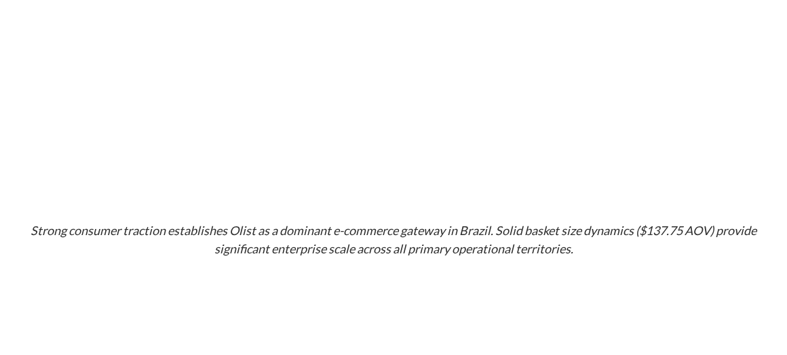

Executive Sales Analytics Snapshot
$13.5M
98,666
$137.75
112,650
TOTAL GMV REVENUE
EXECUTED ORDERS
AVERAGE ORDER VALUE
PRODUCTS SOLD
Gross Merchandise Value
Completed Transactions
AOV Per Basket
Across Marketplace

Slide 4

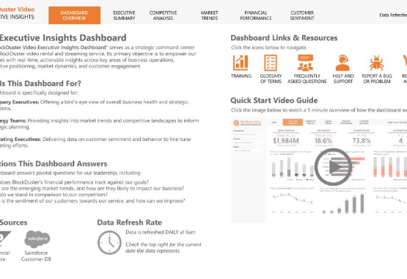
Robust BI Data Architecture
•
Data Cleansing: Automated Python scripts clean raw e-commerce logs, removing anomalies across 98k+ sales records.
•
Feature Engineering: Power Query transforms raw attributes to calculate precise delivery durations and revenue metrics.
•
Dynamic Modeling: DAX measures calculate real-time GMV, regional sales distribution, and shipping margins.
•
Executive Scale: Optimized enterprise model ensures sub-second dashboard query responsiveness.

Slide 5
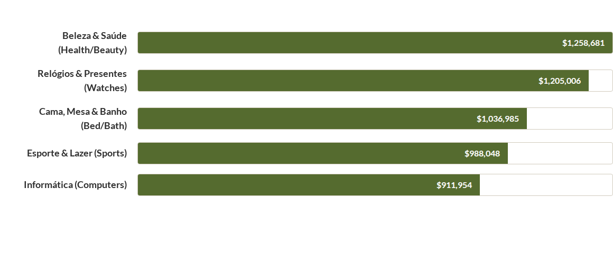
Top Revenue-Generating Categories
Health & Beauty and Watches lead overall marketplace gross turnover, exceeding $1.2M each. Everyday consumer goods and technology accessories account for over 40% of overall platform gross merchandise value.

Slide 6
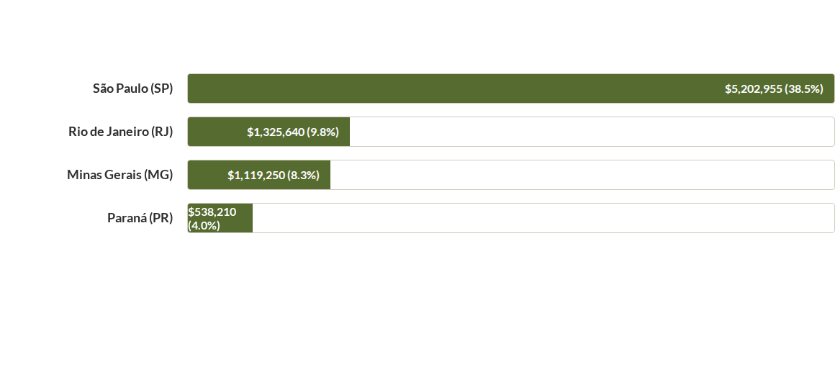
Regional Revenue Breakdown
São Paulo (SP) serves as the core commercial powerhouse, generating over $5.2M in direct sales. Expanding seller density in RJ and MG represents the primary high-yield territorial expansion target.

Slide 7

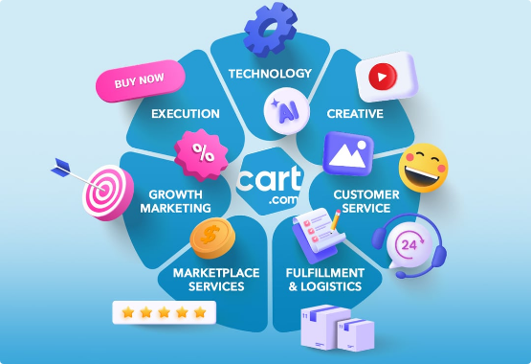
Customer Base & Geospatial Density
High Buyer Concentration
•
41,375 SP Buyers: São Paulo represents 42% of the entire national customer base, creating dense delivery corridors.
•
12,852 RJ Buyers: Rio de Janeiro forms the second largest market segment with sustained order frequency.
•
11,635 MG Buyers: Minas Gerais completes the primary commercial cluster in Southeast Brazil.
•
Retention Opportunity: High geographic density allows for dedicated local fulfillment hubs.

Slide 8
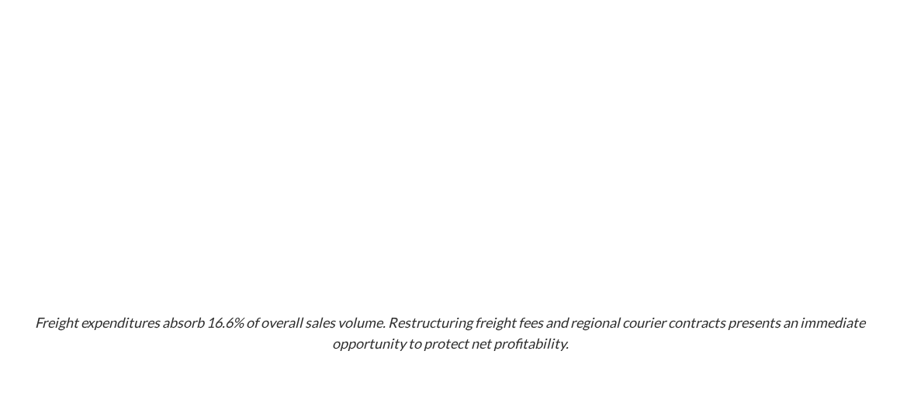
Freight Cost vs. Gross Revenue
Metric Segment | Total Volume | Pct of Total GMV | Operational Impact
Gross Merchandise Value (GMV) | $13,590,000 | 100.0% | Primary Marketplace Revenue Driver
Total Freight Expenditures | $2,250,000 | 16.6% | Significant Direct Margin Compression
Net Seller Yield (Pre-Fee) | $11,340,000 | 83.4% | Merchant Retained Revenue
Avg Freight Per Order | $22.80 | 16.5% of AOV | Key Factor in Cart Abandonment Risk

Slide 9
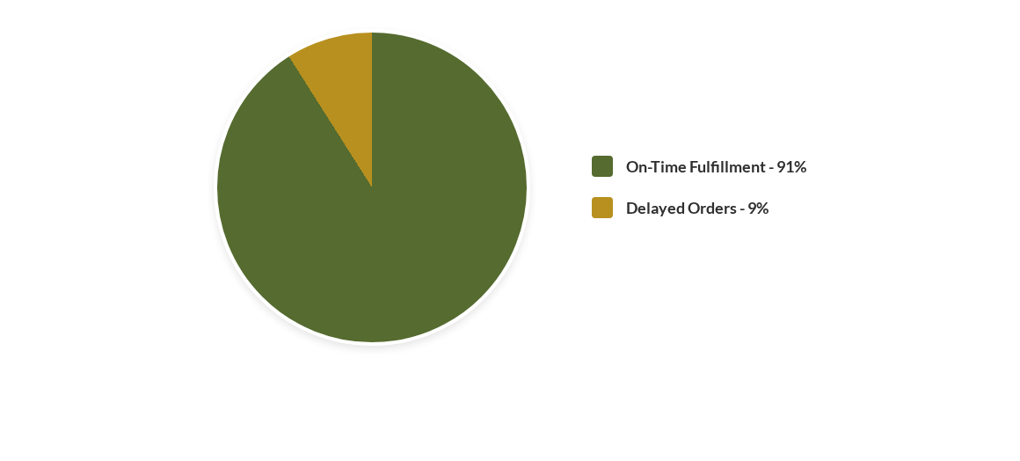
Supply Chain Fulfillment & SLAs
Average order fulfillment takes 12 days nationwide. However, a persistent 9% delivery delay rate negatively impacts customer satisfaction, with peak periods reaching a 17.34% delay rate.

Slide 10
Fulfillment Lead Times by Category
Product Category | Avg Lead Time | SLA Risk | Recommended Logistics Strategy
Móveis Escritório (Office Furniture) | 20 Days | Critical | Contract dedicated heavy-cargo regional carriers
Artigos de Natal (Christmas Items) | 15 Days | High | Implement seasonal pre-fulfillment stockpiling
Seguros e Serviços (Services) | 15 Days | High | Automate digital fulfillment validation SLAs
Ferramentas Jardim (Garden Tools) | 13 Days | Medium | Optimize packaging density to lower freight cost

Slide 11
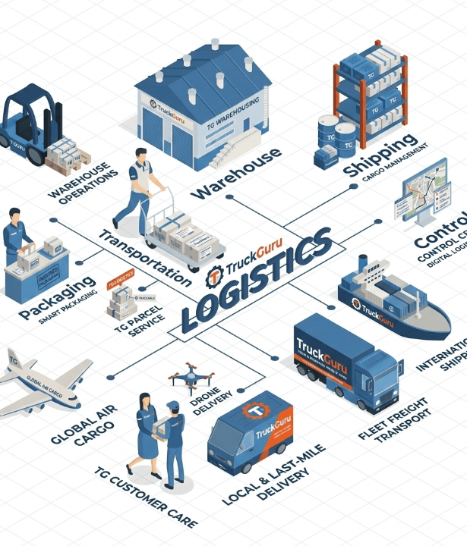
Integrated Commercial Insights
SP Delivery Paradox: São Paulo accounts for $5.2M in revenue but suffers from severe seller delays, directly causing order cancellations.
Bulky Item Margin Squeeze: Heavy categories like Office Furniture suffer 20-day transit times, driving up freight costs while lowering buyer NPS.
Peak Season Scalability: Q2 sales spikes (exceeding $1.5M/mo) bottleneck local logistics hubs, creating predictable delay clusters.

Slide 12
Strategic Action Recommendations
Scale Top Category Sales: Double down on Health/Beauty and Watches ($2.4M combined) through targeted merchant onboarding and featured marketplace placement.
Restructure Regional Freight: Negotiate volume-discounted courier contracts in SP and RJ to reduce the 16.6% freight drag on gross revenue.
Establish Micro-Fulfillment Hubs: Position local fulfillment centers in São Paulo to resolve the 9% delay bottleneck and reduce order cancellation rates.
Enforce Strict Seller SLAs: Implement seller compliance thresholds for bulky items (e.g. Office Furniture) to maintain delivery SLAs under 14 days.

Slide 13
Questions & Discussion
OLIST Brazilian E-Commerce BI Platform
PREPARED BY ENG. ISLAM AL-ZQAQY

Slide 14




Image Sources
https://deliveringdataanalytics.com/wp-content/uploads/2024/03/1-Dashboard-Overview-Tab-1024x576.jpg
Source: deliveringdataanalytics.com
https://cart.com/hs-fs/hubfs/services_360%20managed%20commerce.jpg?width=1080&height=1080&upsize=true&upscale=true&name=services_360%20managed%20commerce.jpg
Source: cart.com
https://truckguru.co.in/blog/wp-content/uploads/2026/03/Gemini_Generated_Imtruckguru.png
Source: truckguru.co.in
https://tensionautomation.com/wp-content/uploads/2024/06/iStock-2150292204-1200x675.jpg
Source: tensionautomation.com

